Slide 1


Sentiment analysis of movie reviews
GA DSI-SG-26 Capstone
By: Matthew Lio

Slide 2
Agenda
Introduction
Background
Problem Statement
Data Analysis
Cleaning
Exploratory Data Analysis
Modelling
Machine Learning and Lexicon
Deep Learning and RNN
Conclusion
Model Insights
Limitations & Future Work

Slide 3

Introduction
Background
Problem Statement

Slide 4
“Any business is obliged to understand their clients, their needs, opinions, and their satisfaction with the product.”

Slide 5


FEEDBACK IS IMPORTANT
Star ratings
Reviews

Slide 6

Feedback
Users
Positive Feedback
Negative Feedback
Customers’ satisfaction
Product promotion
Shortcomings
Suggestions for improvement
Increase customer pool
Increase revenue
Business growth
Improvement of products

Slide 7

Opinion Mining & Collection of Data
Active Collection of Data
Incentivising customers to review
Sponsoring products

Slide 8

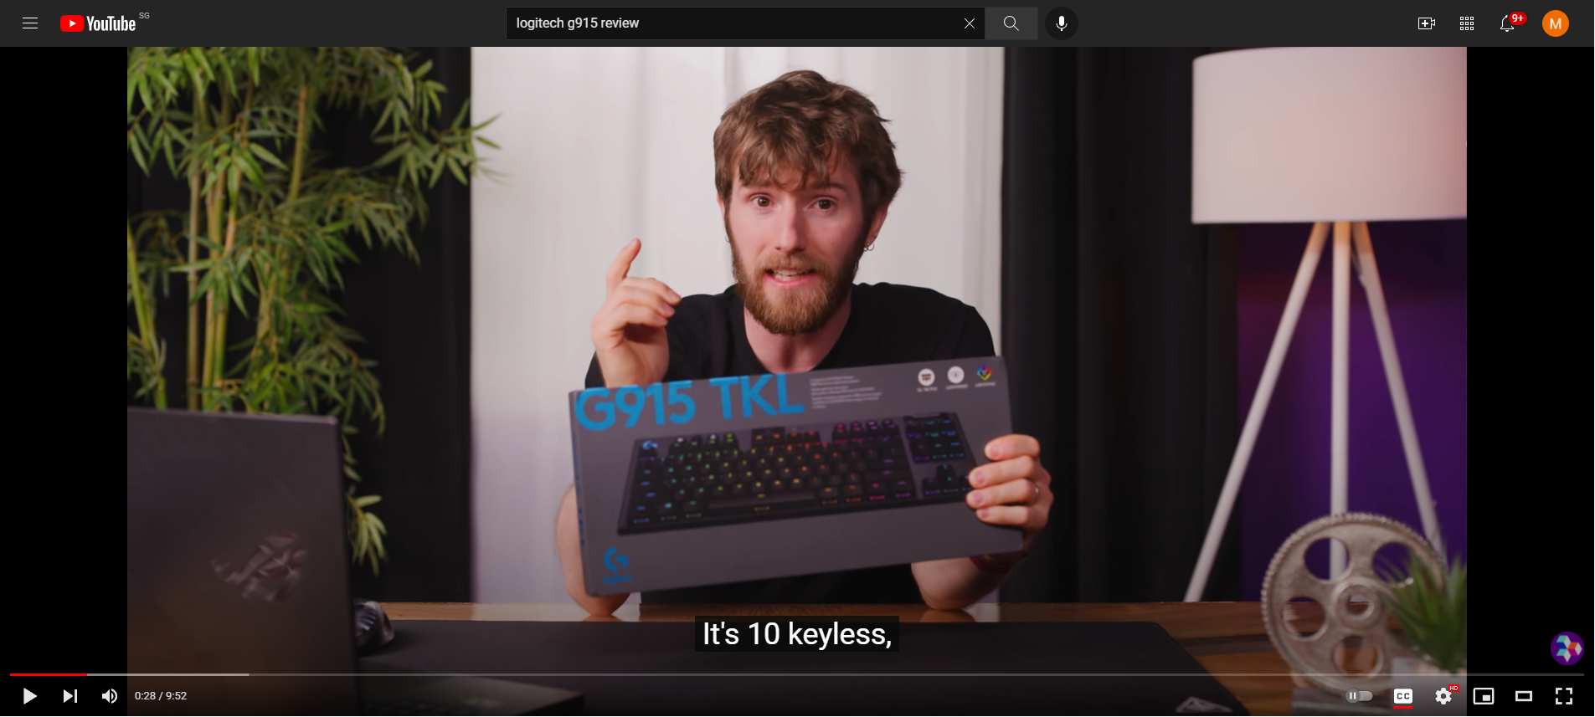







Content Creators
Influencers
YouTubers

Slide 9

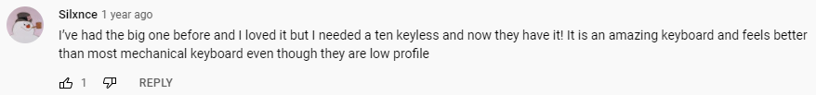
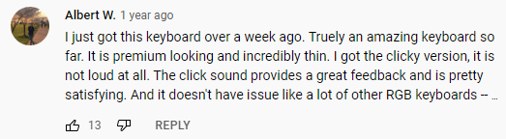


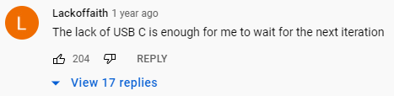
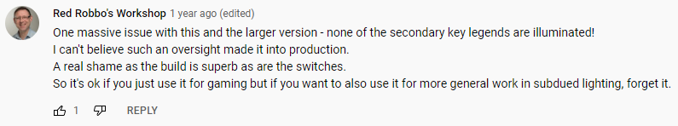
The Problem
Thousands of unrated reviews and comments!
UNTAPPED DATA

Slide 10
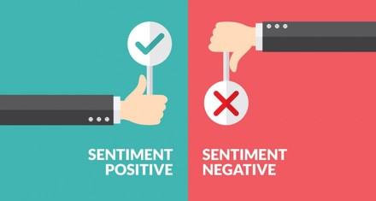
solution
To create a model that classifies the polarities of sentiments effectively in texts using sentiment analysis

Slide 11

NLP: SENTIMENT ANALYSIS
A natural language processing (NLP) technique
The task of classifying polarity of a given text, whether expressed opinion in sentences are positive or negative
Model would be able to sieve through thousands of unrated reviews/comments and effectively classify them to sentiment polarities

Slide 12
Methodology
&
Workflow
1. Cleaning & EDA
Data Cleaning
EDA with stopwords
EDA w/o stopwords
VADER
AFINN
TextBlob
3. ML Models
LR, NB, KNN
Ada, GB, XGB
DT, ET, RF
2. Lexicon Models
4. Deep Learning
5. Evaluation
RNN (LSTM)
RNN (GRU)
Metrics evaluation
Further improvements

Slide 13

Data Analysis Dataset: IMDB Movie Reviews
Data Cleaning
EDA (With removal of stopwords)
EDA (Without removal of stopwords)

Slide 14
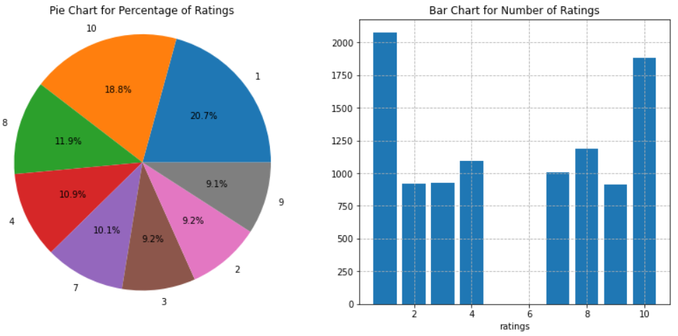
Data Cleaning
Removing links
Removing <br>
Removing special characters
Removing duplicate reviews
Lowercase all letters
Tokenizing
Lemmatizing

Slide 15
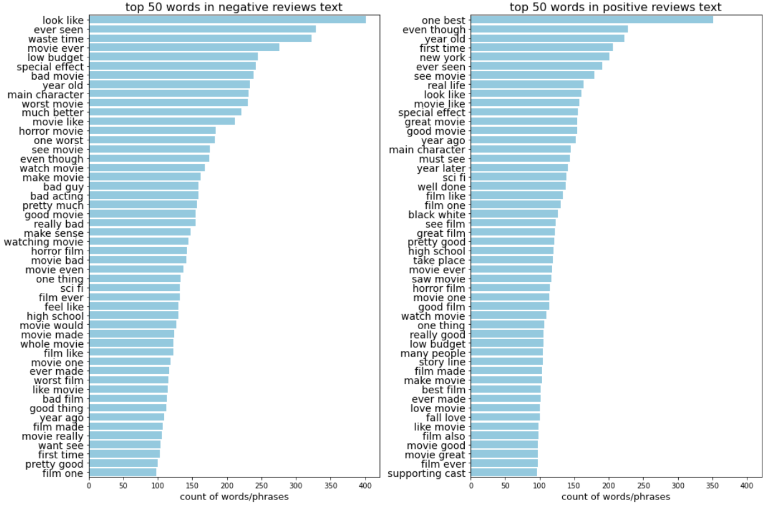
EDA (With removal of stopwords)

Slide 16
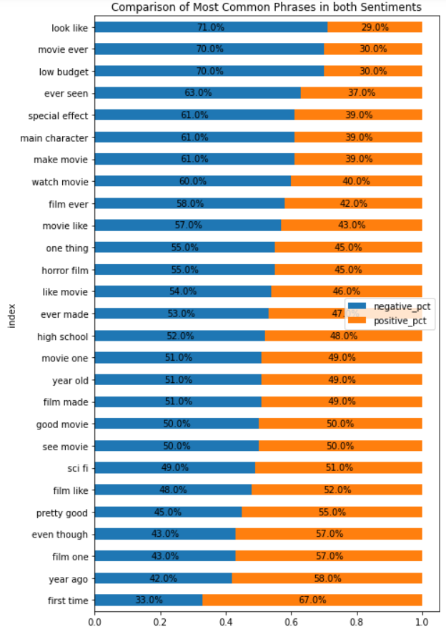
Most common phrases in both polarities

Slide 17
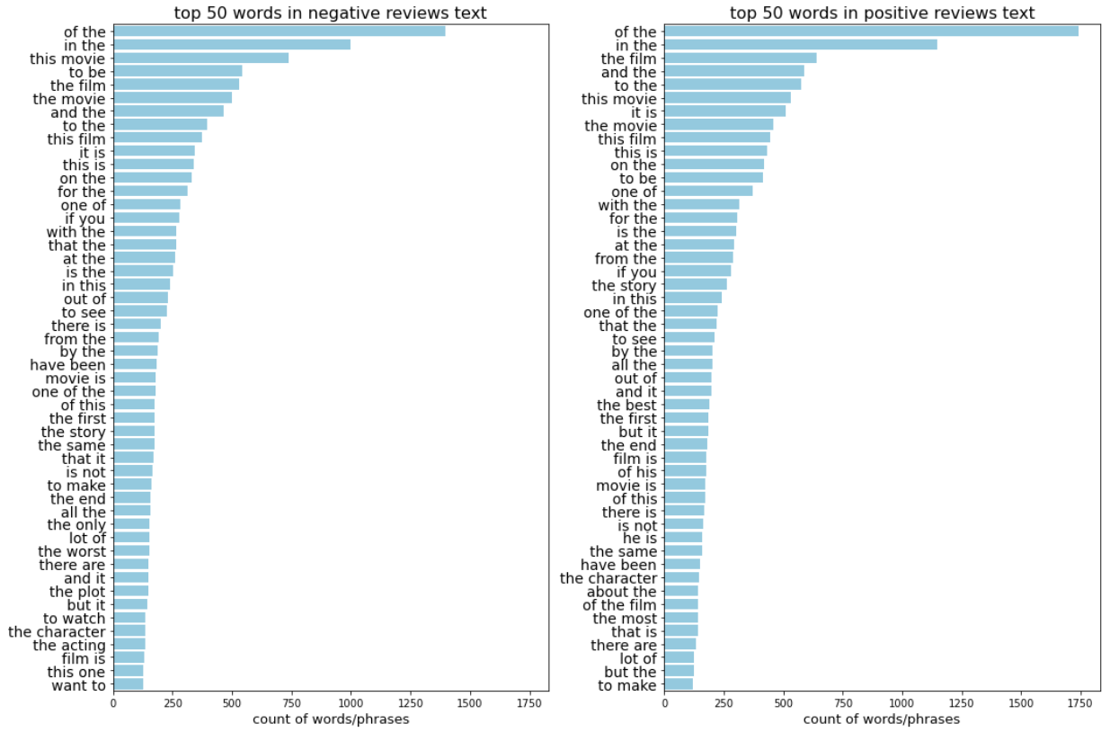
EDA (Without removal of stopwords)

Slide 18
Evaluation Metrics
ROC AUC
Better than accuracy.
ROC AUC calculated based on predicted scores
Accuracy
Easily interpretable
Helpful to explain to non-technical stakeholders
Specificity
Correct predictions of Negatives
Negatives may be more important than positive reviews
Need to be robust if dataset is imbalanced, with lesser negatives
ROC AUC
Accuracy
Specificity

Slide 19
Lexicon-based Models
Lexicon means the vocabulary of a person, language or branch of knowledge
Every word in the dictionary contains a corresponding sentiment score to it
Combining function makes the final sentimental prediction regarding the total text component
ISSUES
Meaning of the whole corpus might be different than each individual words used, based on phrases or sentences that imply sarcasm or in a context of comparison
VADER Lexicon
AFINN Lexicon
TextBlob Lexicon

Slide 20
Lexicon Models: Incorrect Predictions
zero day lead you to think even re think why two boy young men would do what they did commit mutual suicide via slaughtering their classmates. it capture what must be beyond a bizarre mode of being for two human who have decided to withdraw from common civility in order to define their own mutual world via coupled destruction. it is not a perfect movie but given what money time the filmmaker and actor had it is a remarkable product. in term of explaining the motif and action of the two young suicide murderer it is better than 'elephant' in term of being a film that get under our 'rationalistic' skin it is a far far better film than almost anything you are likely to see. flawed but honest with a terrible honesty.
Out[8]:
{'neg': 0.157, 'neu': 0.702, 'pos': 0.141, 'compound': -0.3816}
there are a lot of highly talented filmmaker actor in germany now. none of them are associated with this movie . why in the world do producer actually invest money in something like this this you could have made good film with the budget of this garbage it's not entertaining to have seven grown men running around a dwarf pretending to be funny. what is funny though is that the film's producer who happens to be the oldest guy of the bunch is playing the youngest dwarf. the film is filled with moment that scream for caption saying you're supposed to laugh now . it's hard to believe that this crap's supposed to be a comedy. many people actually stood up and left the cinema minute into the movie. i should have done the same instead of wasting my time... pain
Out[9]:
{'neg': 0.079, 'neu': 0.768, 'pos': 0.153, 'compound': 0.8907}
Negative, predicted Positive
Positive, predicted Negative
word can't describe how bad this movie is. i can't explain it by writing only. you have too see it for yourself to get at grip of how horrible a movie really can be. not that i recommend you to do that. there are so many clich s mistake and all other negative thing you can imagine here that will just make you cry. to start with the technical first there are a lot of mistake regarding the airplane. i won't list them here but just mention the coloring of the plane. they didn't even manage to show an airliner in the color of a fictional airline but instead used a painted in the original boeing livery. very bad. the plot is stupid and been done many time before only much much better. there are so many ridiculous moment here that i lost count of it really early. also i on the bad guys' side all the time in the movie because the good guy were so stupid. executive decision should without a doubt be you're choice over this one even the turbulence movie are better. in fact every other movie in the world is better than this one.
Out[10]:
{'neg': 0.122, 'neu': 0.744, 'pos': 0.134, 'compound': 0.7007}
Negative, predicted Positive. WHY

Slide 21
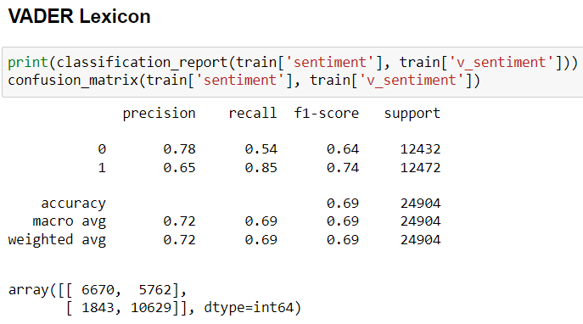
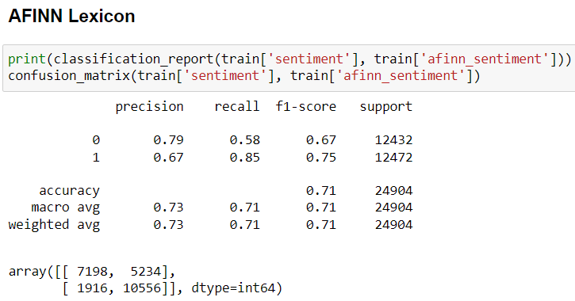
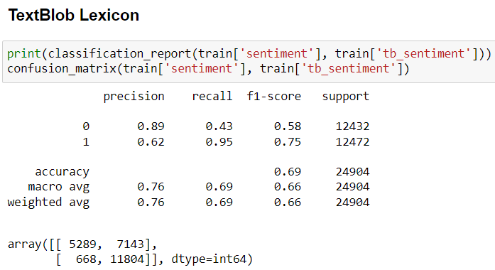
Lexicon Models: Evaluation

Slide 22
Machine Learning Models
Models
Logistic Regression
Multinomial Naïve Bayes
K-Nearest Neighbors
AdaBoost Classifier
Gradient Boost Classifier
XGBoost Classifier
Decision Tree Classifier
Extra Trees Classifier
Random Forest Classifier
Vectorizers
Count Vectorizer
TF-IDF Vectorizer

Slide 23
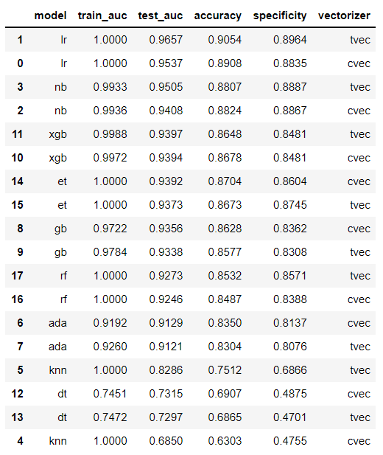
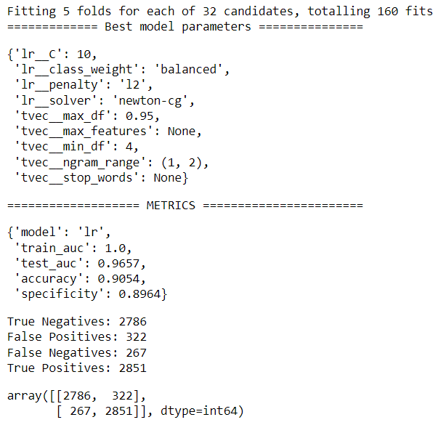
ML Models: Evaluation
BEST!
Logistic Regression with TF-IDF Vectorizer

Slide 24
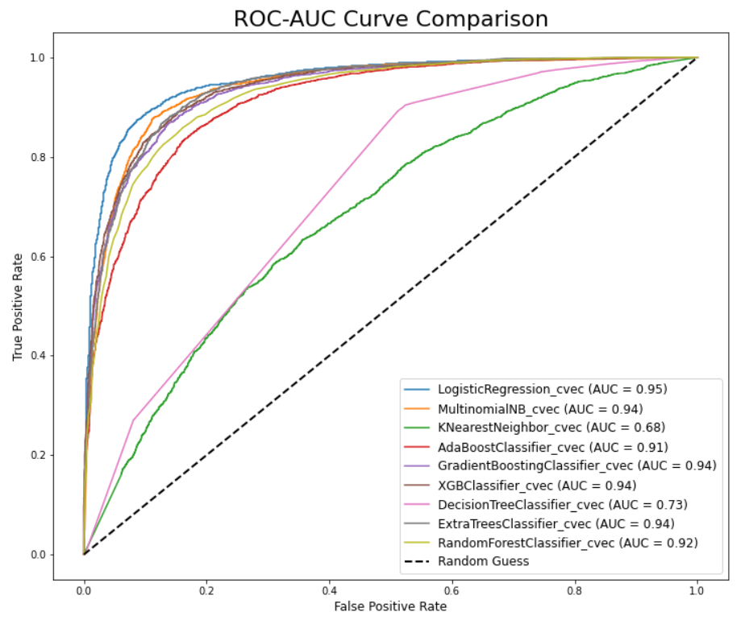
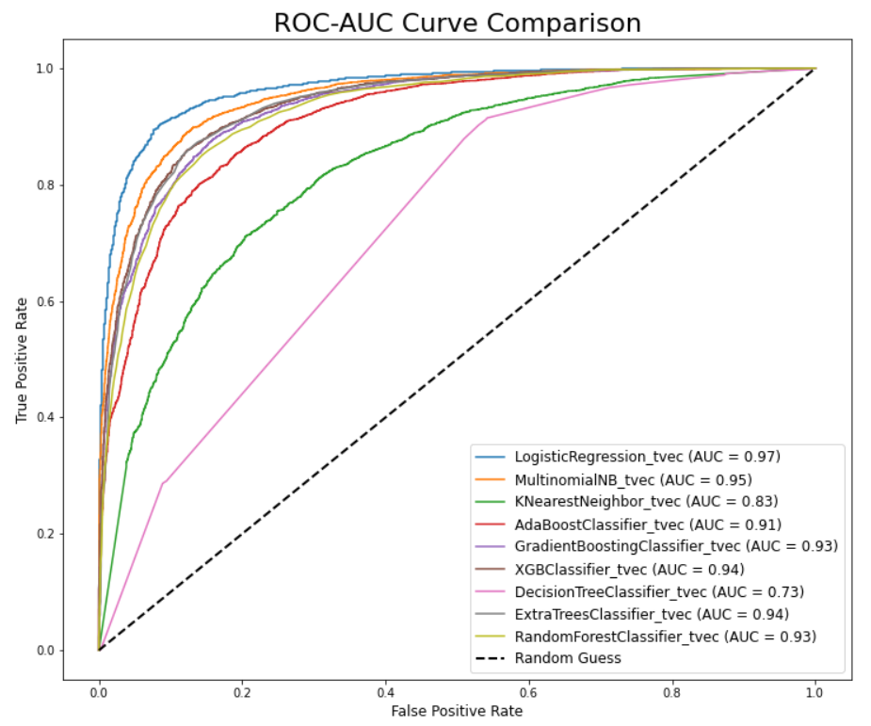
ML Models: ROC AUC Curves
Count Vectorizer
TF-IDF Vectorizer

Slide 25
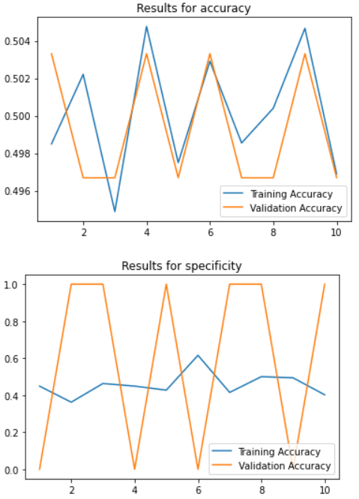
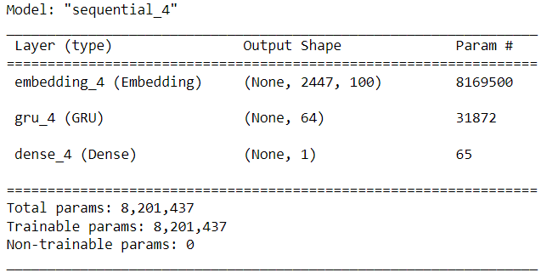
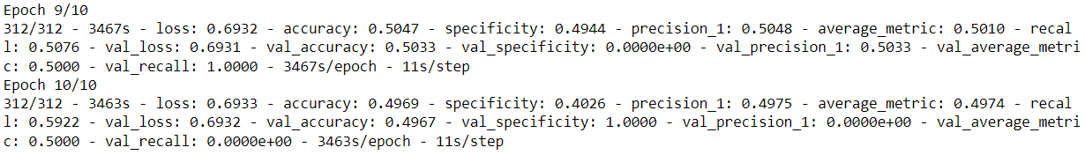
Deep Learning Models: RNN

Slide 26
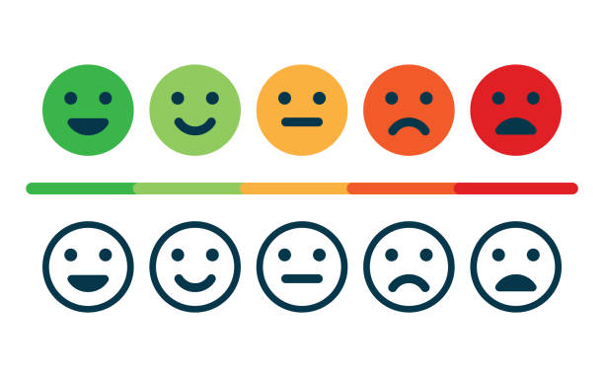
Conclusion & Further Improvements
Best model: Logistic Regression with TF-IDF Vectorizer
Test ROC AUC: 0.9657
Accuracy: 0.9054
Specificity: 0.8964
Use on other balanced datasets
Effective on classifying sentiment polarities
Reviews and comments from untapped data can be utilized for improvement of products, or product promotion/advertising
Further Improvements
Tune RNN
Other deep learning models
Word2vec embeddings
Pre-trained: BERT
Ordinal Regression

Slide 27
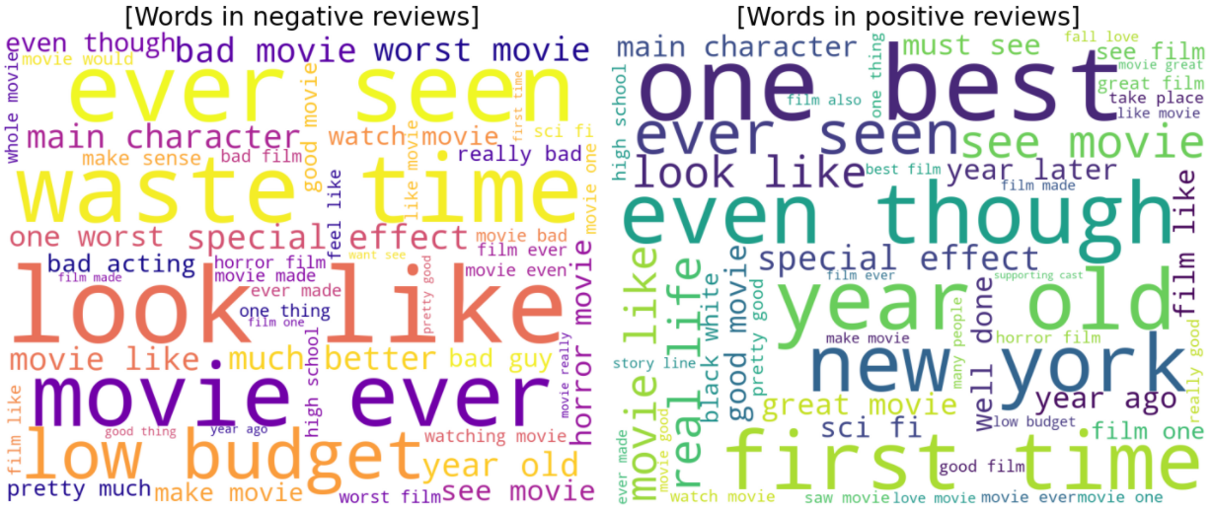
THANK YOU

